Slide 1
PA21-0116 APPEAL Add 2nd Drive Thru LOT 2 PLAZA DE LAS FLORES COMMUNITY OF LADERA RANCH

Slide 2
EXISTING APPROVED SITE PLAN Las Flores HAND Car Wash - 1997

Slide 3
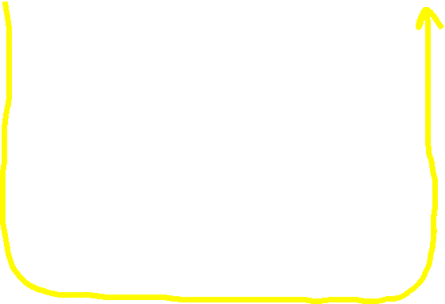
-Note the arrows flowing in a counter clockwise direction, all traffic entering on the left and exiting on the right (yellow line) -Note that all parking in the rear of the lot (bottom) is striped in a traditional method and not slanted.

Slide 4
FRAUDULENT EXISTING SITE PLAN SUBMITTED BY APPLICANT

Slide 5
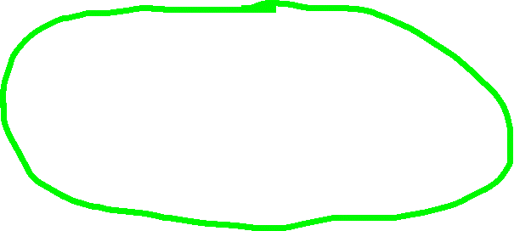
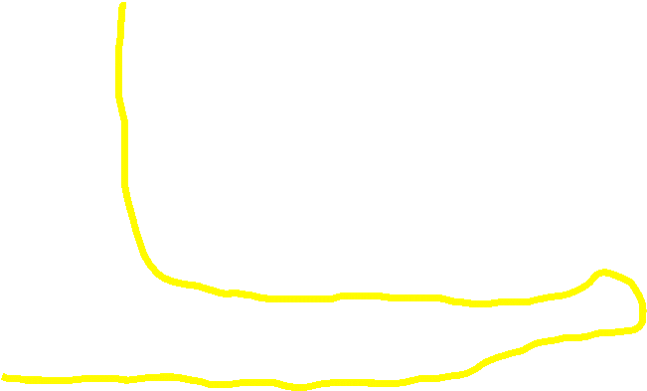
-Note the slanted rear parking that is inconsistent with 1997 existing (green circle) -Note the traffic “S” pattern (yellow line) with traffic entering on the left and curving around exiting across the rear of the property creating a one-way traffic pattern to Lot 5 (Lot 5 Owner and Lot 2 Owner are not the same)

Slide 6
PA 20-0053 (Approved)

Slide 7
PA 20-0053 versus PA21-0116
PA20-0053
PA21-0116
-Creates a drive thru use without a CUP
-Adds Parking Lot on side of building which affects the safety of the Ingress and Egress on Antonio entrance.
-Pushes out the retail building and adds parking in front of the retail building backing directly into the main drive aisle which affects the safety of the customers and burdens access to the balance of the shopping center.
-No notice, or right to object to this Change Plan by other Lot owners in this master planned commercial center.
-Adds a second drive thru of a different use, again without a CUP
-No traffic study of the shopping center Antonio ingress/egress and drive aisles.
-Cuts the existing building in half to create drive-thru
-Second drive through affects safety with additional cars queuing to enter the drive thru and exit of the drive thru
-Three local schools where children walk or bike to patronize center are in jeopardy with this design.
-No notice given to other Lot owners of this master planned commercial center.

Slide 8
PA21-0116

Slide 9
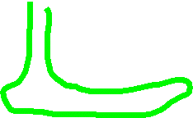

This 2nd retail drive thru would not be feasible without the county first approving the change plan (PA20-0053)due to a fraudulent site plan submitted by the applicant. This changed the direction of traffic, exiting the car wash patrons across the back of Lot 5 creating a one way only situation and establishing a “new” existing site plan.

Slide 10
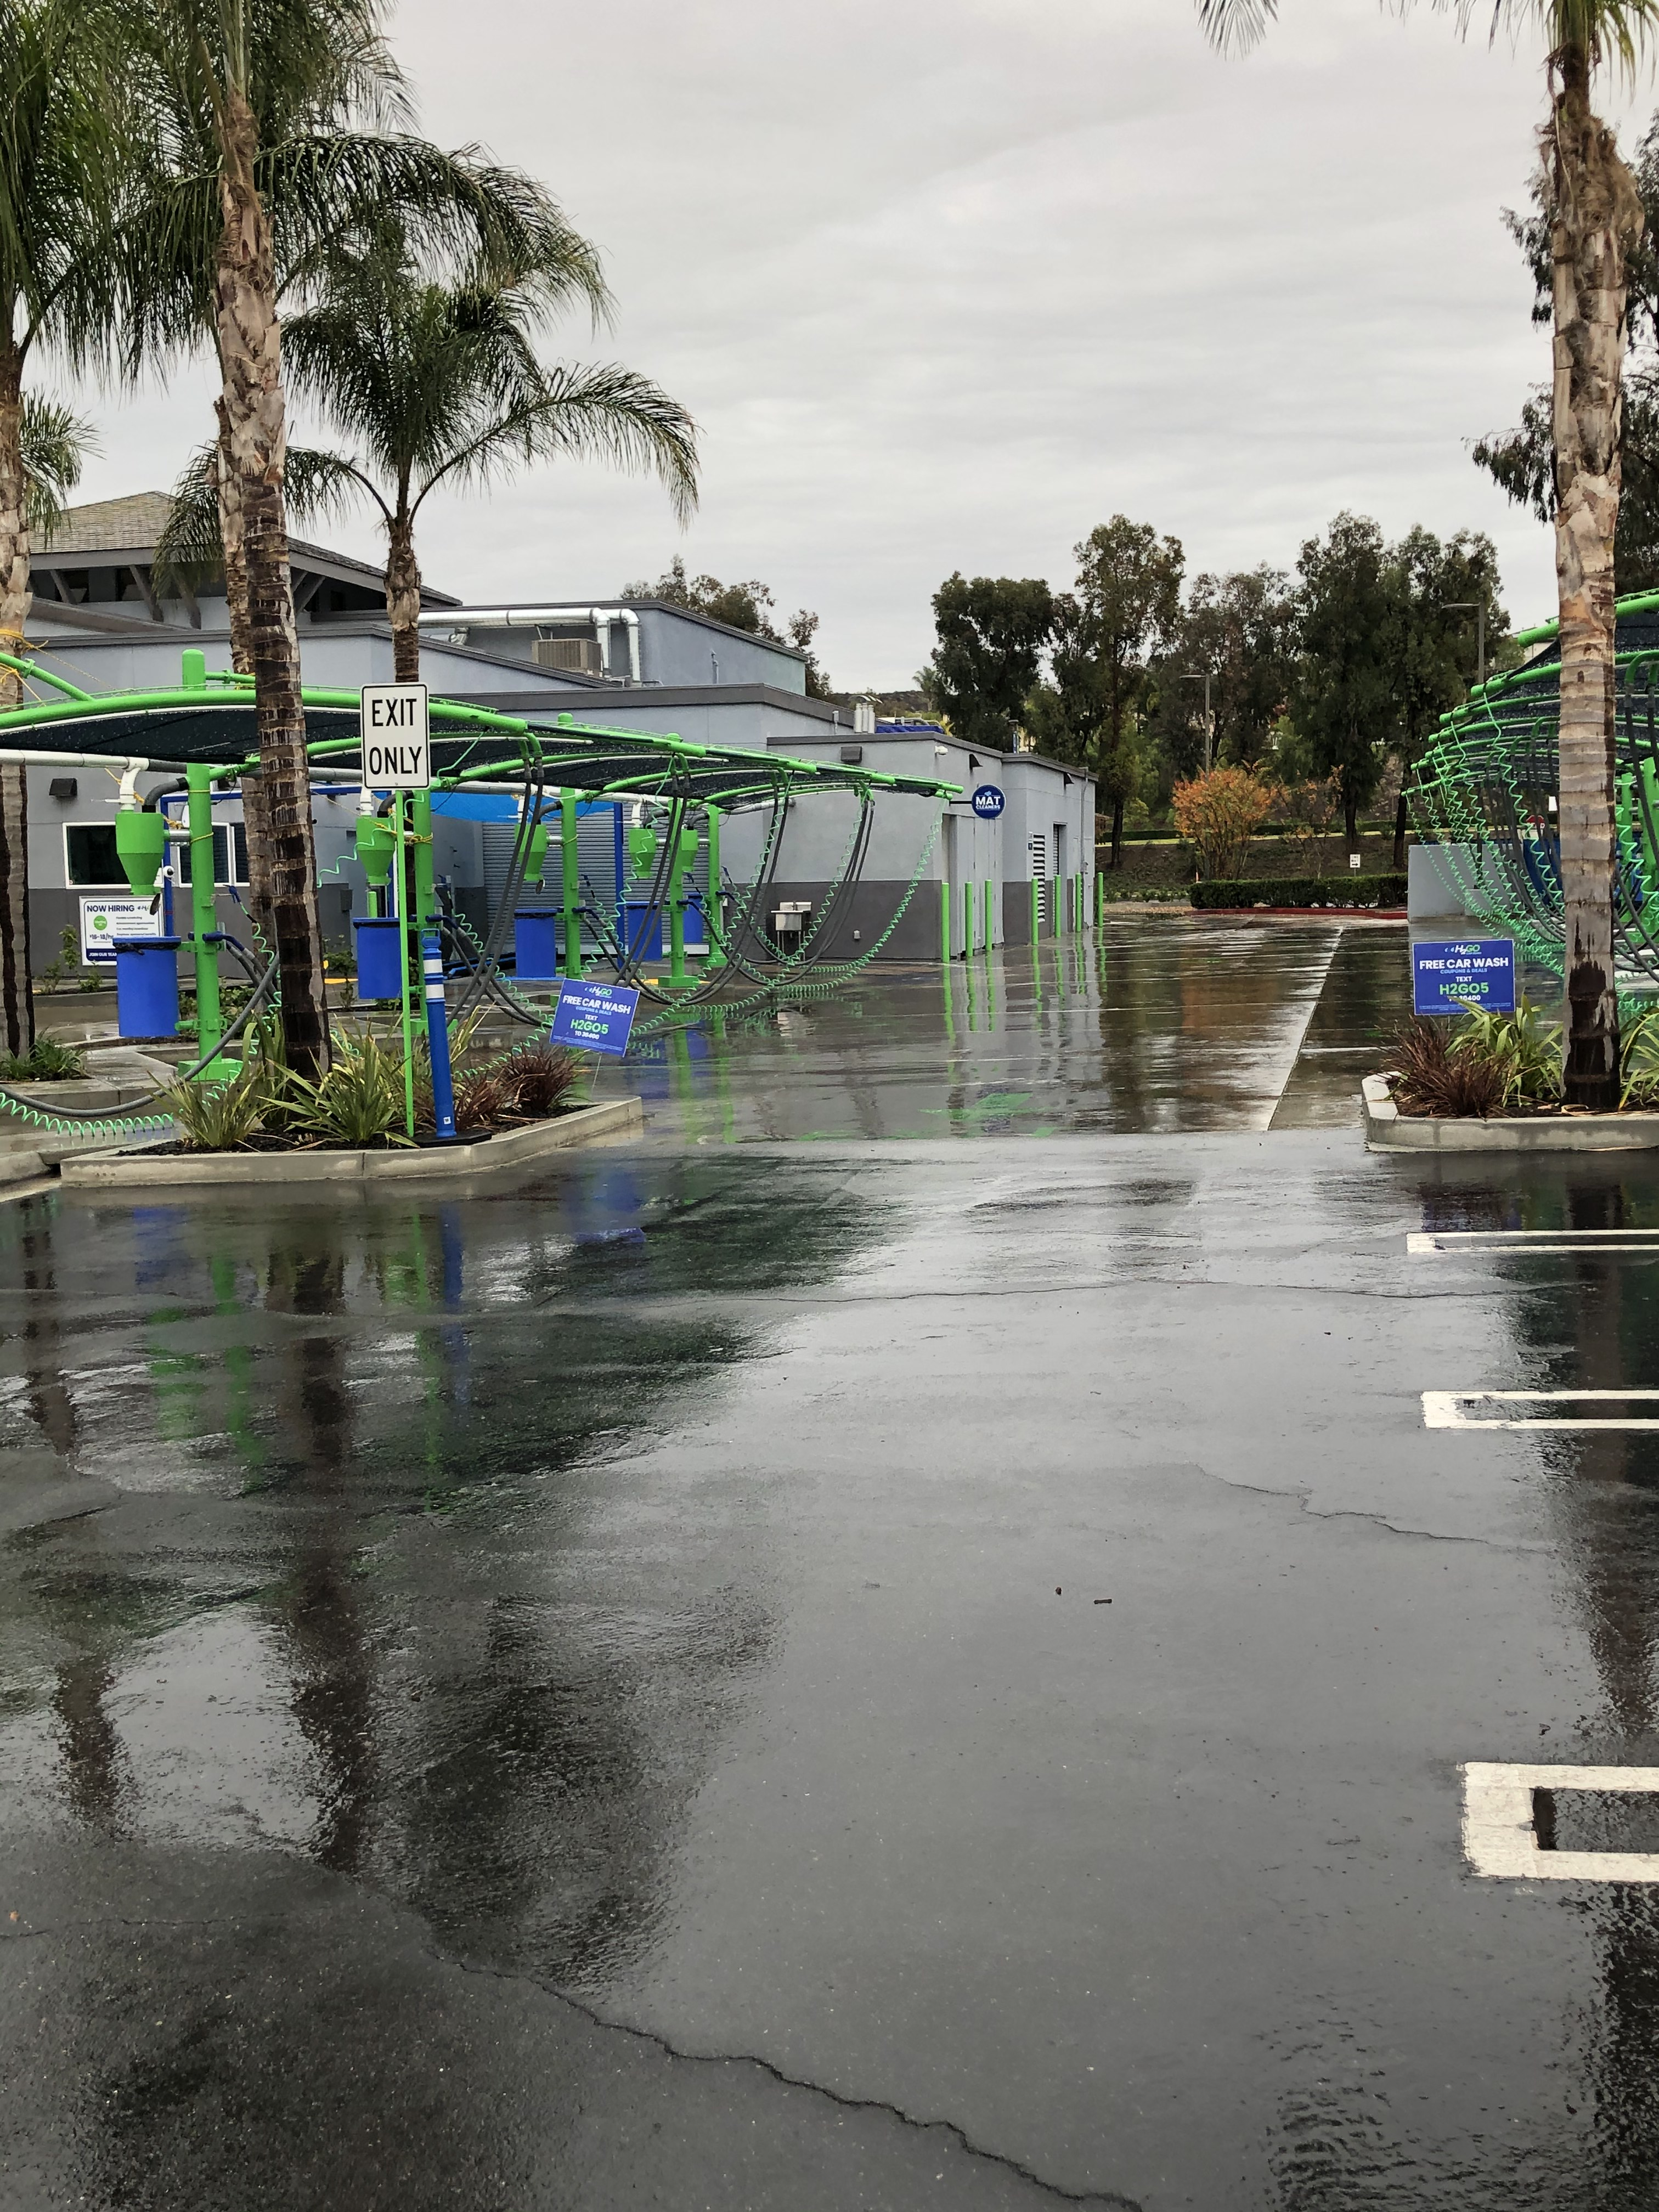
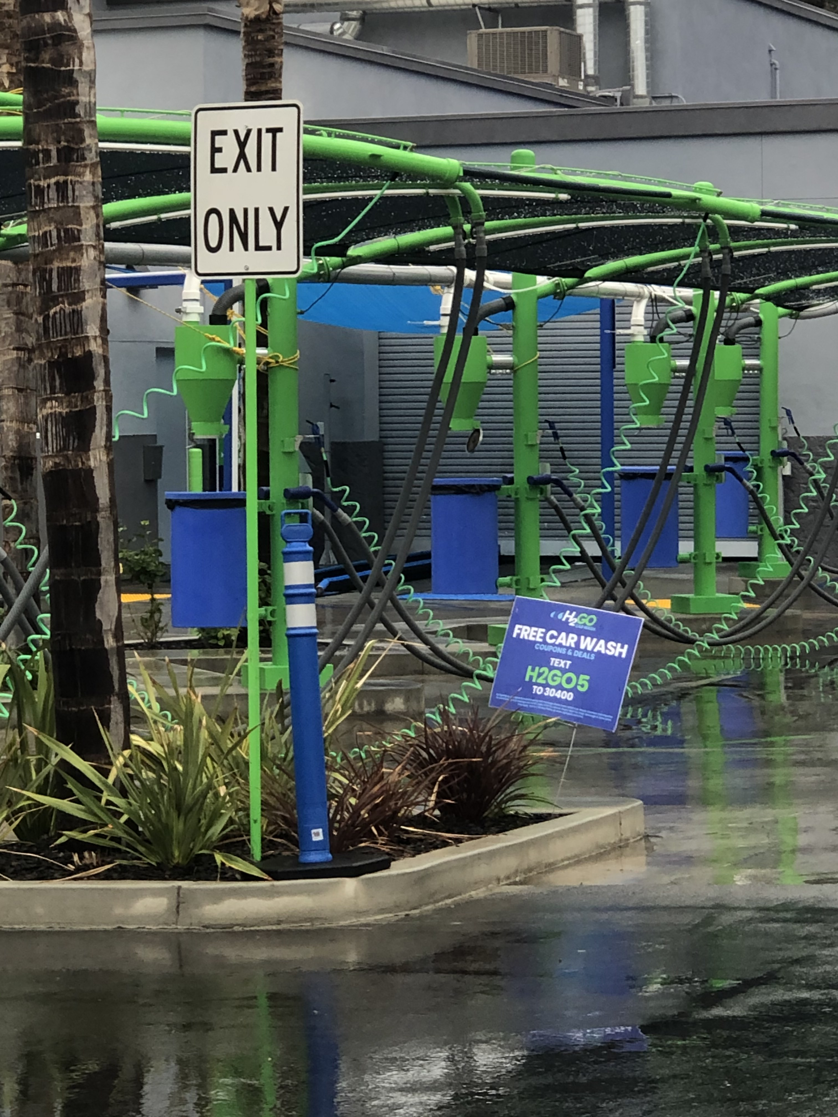
New One Way Exit Only FROMLot 2 to Lot 5

Slide 11
Safety Concerns

Slide 12
-Red outlined cars traveling on Antonio (50mph) -Red block cars entering center -Black block cars exiting center onto Antonio -Rust color is exit of proposed Starbucks drive thru
GAS STATION
-Extreme safety issues with cars turning into center off Antonio and turning left to park in lot (red blocks)
-Black cars waiting to exit block drive-thru exit and east parking lot entrance
-Drive-thru exit dangerous as traffic flows cross-wise and diagonal in front of exit
Drive-thru exit

Slide 13
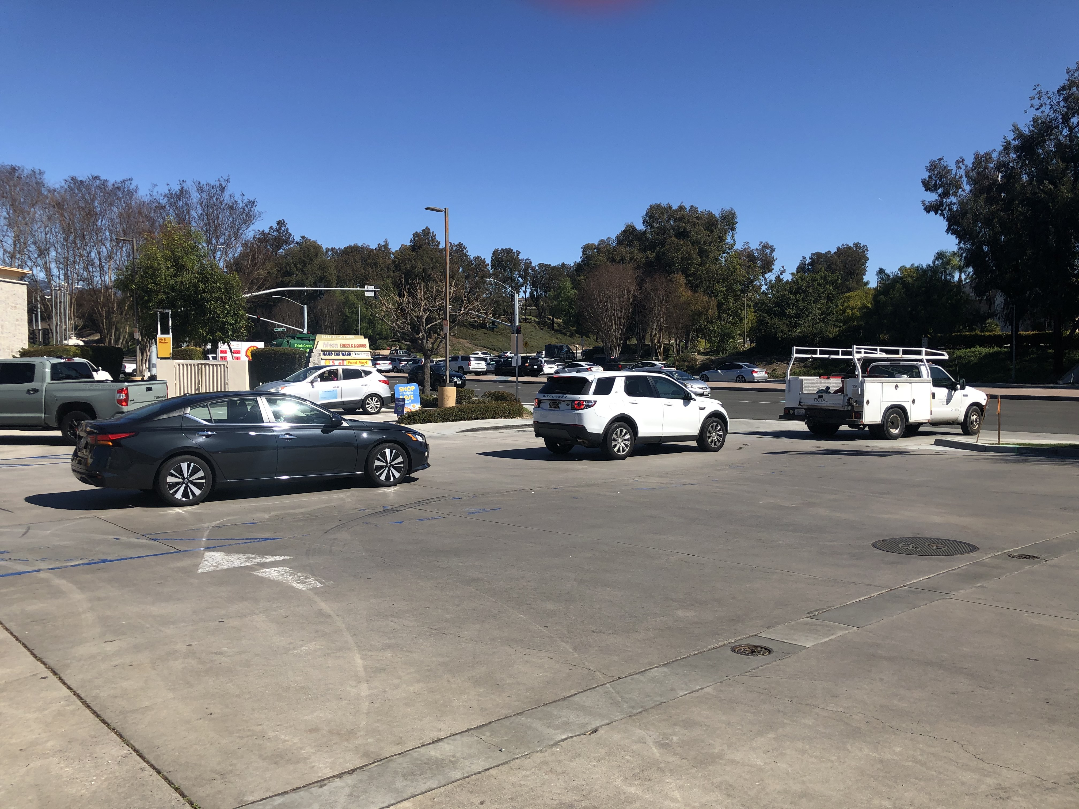

Slide 14
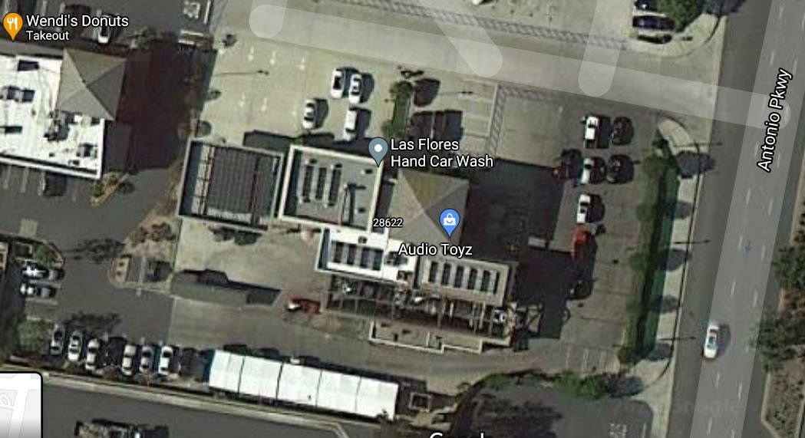

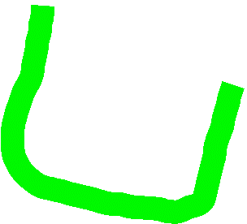
-Cars turning into Starbucks Drive-Thru and Car Wash Drive-thru can back up traffic in drive aisle
Car Wash Drive-thru
Coffee Drive- Thru
Gas Station
-Blue Outline Cars backing out of Starbucks into main drive aisle
-Blue Cars are new parking on East side of building

Slide 15
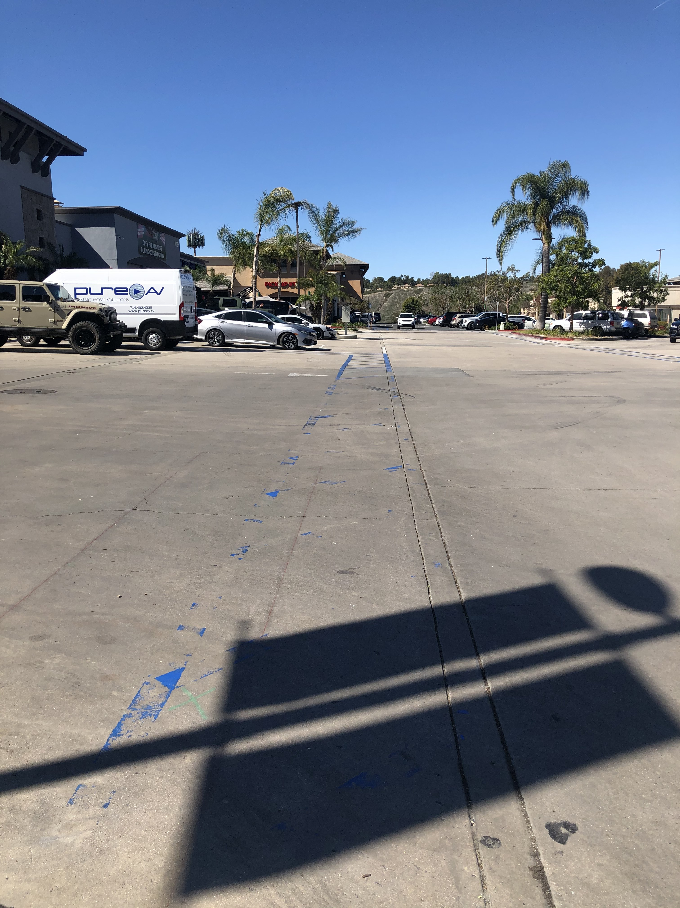
Parking backing into main drive aisle

Slide 16
CONCLUSION
TRAFFIC SAFETY ISSUES, FOR CARS AND PEDESTRIANS, HAVE BEEN CREATED AT THE ANTONIO ENTRANCE WHICH COULD RESULT IN COLLISION AND POSSIBLE SEVERE HARM SHOULD THIS APPLICATION BE APPROVED.
TRAFFIC SAFETY ISSUES, FOR CARS AND PEDESTRIANS, HAVE BEEN CREATED IN THE MAIN DRIVE AISLES LEADING TO THE BALANCE OF THE SHOPPING CENTER WHICH COULD RESULT IN COLLISION AND POSSIBLE SEVERE HARM.
DUE TO THE FORMER APPROVAL OF PA20-0053, THE COUNTY HAS TAKEN AWAY THE RECIPROCITY BETWEEN LOT 2 AND LOT 5, THUS COMPROMISING FUNCTION ON LOT 5.
IF THE APPLICATION IS APPROVED AND AN ACCIDENT OR INJURY OCCURS, THE OTHERS LOTS IN THE SHOPPING CENTER COULD POTENTIALLY BE HELD LIABLE AS THESE MAIN AISLES ARE CONSIDERED INGRESS/EGRESS TO THE OTHER LOTS.
PLEASE DENY THIS APPLICATION OR REQUEST A MORE THOROUGH TRAFFIC STUDY OF THE INGRESS/EGRESS AND MAIN DRIVE AISLES TO BE CONSIDERED.

